Slide 1
Overview of new devices in the era of Beyond CMOS
2024/05/14
MegaChips Corp
yoshitomi.sadayuki@megachips.co.jp

Slide 2
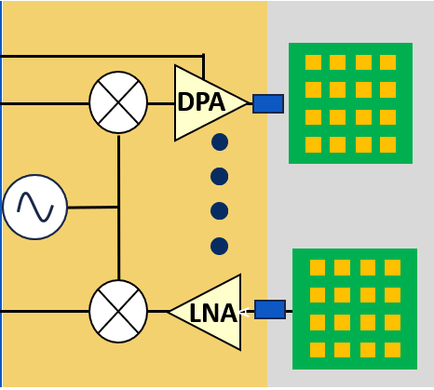

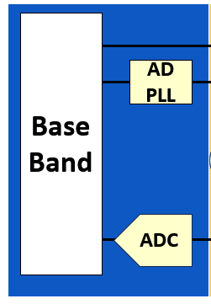
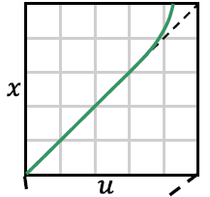

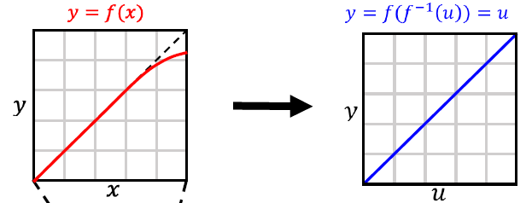
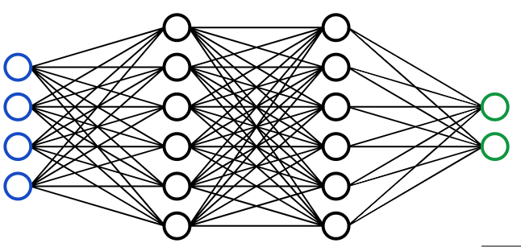
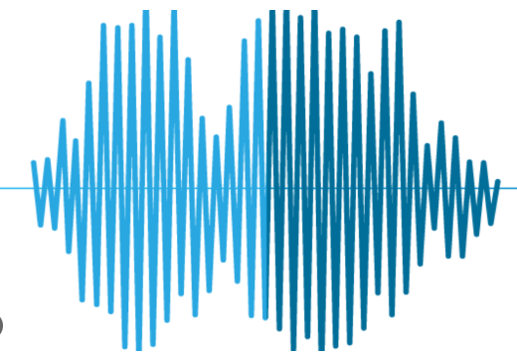
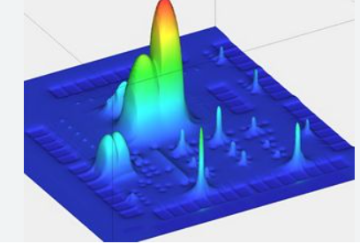
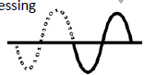
Keywords of device developments for 2030
More than Moore
Speed/Linearity/Noise
More Moore
Speed/Power
Antenna
Integration
Beyond CMOS
Spectrum
&
Interference
Management
BY Cognitive
Signal
Conditioning
Smart DPD
Dense Integration/
Speed/Power
Training
Smart-DPD
Algorithm

Slide 3
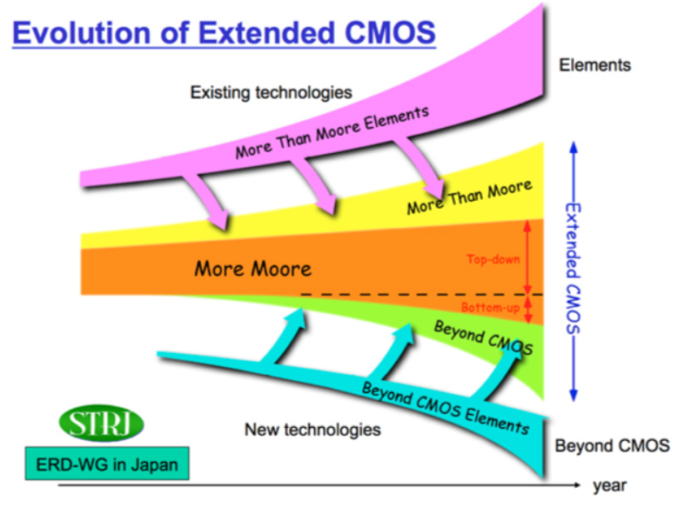
Portfolio of Extended CMOS developments.
+ Increase the add value
-> Integrate various functions
(RF, power, passive elements,
sensors, actuators)
other than digital logic into LSIs.
+ Performance for digital
Further scaling of MOSFETs
to improve the performance of LSIs.
-> new materials and structures are
essential.
+ Improve the performance
-> using devices that operate
on a different principle to
MOS transistors.

Slide 4
Contents
1. Throw back to the era of MOS transistors’ scaling.
2. New materials and structures for further scaling
of MOS transistors.
3. Fighting with Layout Parasitic Elements to conquer
More than Moore.

Slide 5
Throw back to the era of MOSFET scaling

Slide 6
Revisit to R.H Dennard’s scaling rule (~ 50 Years)
R.H Dennard et al., IEEE JSSC 9, 256 (1974)
Electrical Field = Constant
Before
After
L_{G}
L_{G}/α
Gate
Gate
T_{OX}
T_{OX}/α
Source
Drain
Source
Drain
W_{D}/α
N_{a}
W_{D}
Depletion
Layer Width
αN_{a}
Impurity Concentration
in the Channel (substrate)
V_{DD}/α
Width W/α
Integrated Density → α²
Delay → 1/α
Power consumption/Device → 1/α²

Slide 7

Gap between theory and reality..
We want this !
Channel (Inversion Layer)
NMOS-Electrons
PMOS-Holes
Log10(I_{D})
Gate
But..
I_{ON}
Source
Drain
Current
I_{OFF}
I_{S}
V_{GS}
Subthreshold region
Why we cannot realize what we want ?
What is a problem and how to solve this ?

Slide 8
Challenges in MOSFETs Scaling (1/2)
I_{OFF}↑ Leak increases.
↑（I_{G}）Gate Leak Current
↑（I_{J}）Junction Leak S/D and Backgate
↑（I_{S}）Subthreshold Leak ← Short-channel Effect
Log10(I_{D})
Gate
I_{ON}
I_{G}
Source
Drain
I_{ON}
Scaling
I_{OFF}
I_{J}
I_{S}
I_{S}
V_{GS}
Subthreshold region

Slide 9
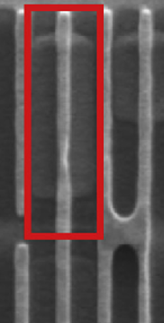
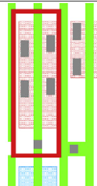
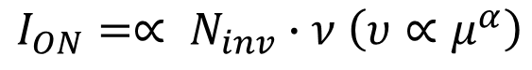
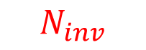

Challenges in MOSFETs Scaling (2/2)
Ion degrades from the expectation
$$ν$$
Gate
DC: Leveling off due to impurity scattering.
$$N_{inv}$$
$$I_{ON}=∝ N_{inv}∙ν \left(υ∝μ^{α}\right)$$
I_{G}
Source
Drain
Concentration
Velocity
Mobility
I_{ON}
AC:Parasitic R/C in MOSFET and BEOL
Unwanted Increase of variation
-σ（V_{TH}） ↑ Due to larger
σN_{inv}
Ninv : from Boltzmann statistic
to discretized numbers
-σ（Leff) ↑ Due to Lithography Process

Slide 10
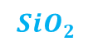
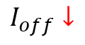
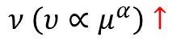

Footprints of innovation of planar CMOS
Strained Silicon
Gate
Gate
High-K
Dielectric Film
I_{G}
I_{G}
Source
I_{ON}
Drain
Source
I_{ON}
Drain
I_{S}
I_{J}
$$S_{i}G_{e}$$
I_{S}
I_{J}
Gate
I_{G}
$I_{off}↓$
$ν \left(υ∝μ^{α}\right)↑$
Gate Leak Reduction
Mobility Enhancement
Source
Drain
Low parasitic BEOL (Back End Of Line)
Silicon On Insulator
I_{ON}
Gate
I_{S}
I_{J}
Cupper Metal
Low-K
Dielectric Film
I_{G}
Source
I_{ON}
Drain
I_{J}
$$SiO_{2}$$
Reduction of channel to Body Capacitance.
Reduction of propagation delay of BEOL.
Lots of innovations are well done for planar CMOS.
Go to a next step for a new era !

Slide 11
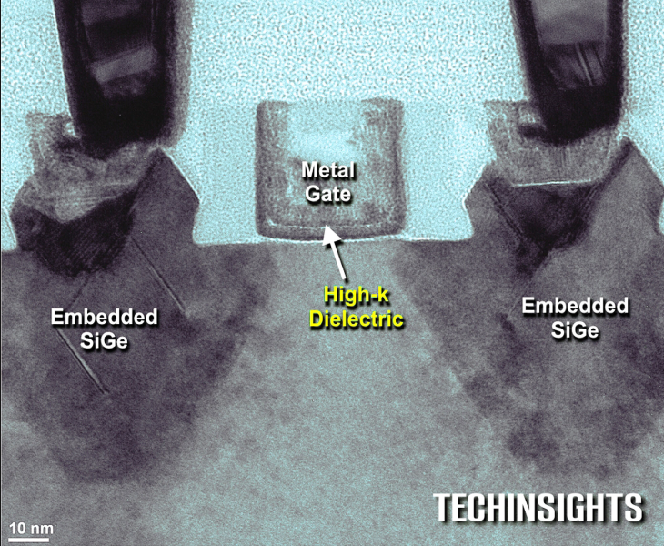
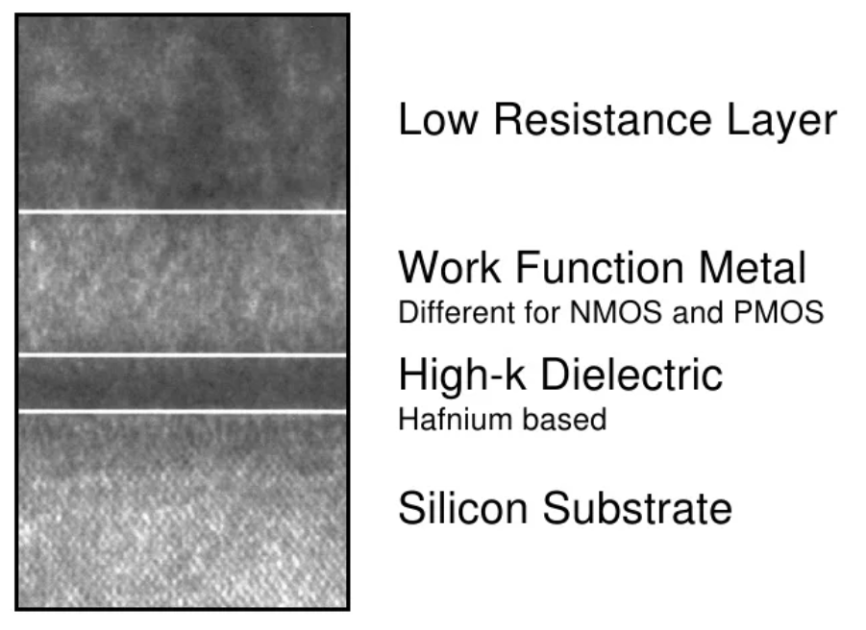
Intel’s 32nm Generation MOSFET
Metal Gate
/High-K dielectric gate insulator
Effective thickness of Gate
Insulator ~ 0.95nm
C.H Jan et al., (Intel) IEDM2008, p.637
P.Packan et al., (Intel) IEDM2009, p.659

Slide 12
New materials and structures for further scaling of MOS transistors.

Slide 13
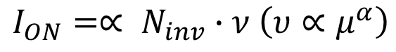
Strategy of enhancement for higher on current.
$$I_{ON}=∝ N_{inv}∙ν \left(υ∝μ^{α}\right)$$
Channel
Doping
Velocity
Mobility
・Explore for high mobility
-Strained Silicon.
-SiGe, Ge
- Ⅲ-Ⅴ materials.
-Carbon Nano-Tube, Graphene.

Slide 14
Mobility Benchmark
 | Si | Ge | GaAs | InAs | InSb
Electron (cm²/Vs) | 1600 | 3900 | 9200 | 40000 | 77000
Hole (cm²/Vs) | 430 | 1900 | 400 | 500 | 850
Band-gap (eV) | 1.12 | 0.66 | 1.424 | 0.36 | 0.17
Pros
Better performance is expected:
Ge-PMOS, Ⅲ-Ⅴ NMOS
Cons
Narrow Bandgap → Leak Current（I_{J}）↑

Slide 15
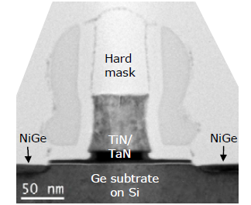
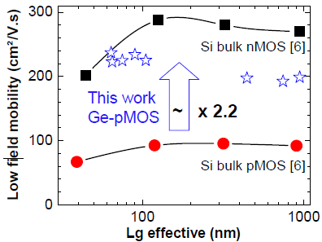
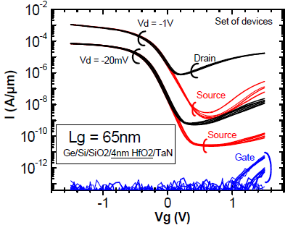
Ge pMOSFET
J. Mitard et. al, ”Record ION/IOFF performance for 65nm Ge pMOSFET
and novel Si passivation scheme for improved EOT scalability”,
DOI: 10.1109/IEDM.2008.4796837
Issues
・Large Leak current (Ij)
・Leakey nature of Gate insulator (GeO2)
・More explore is required for NMOS.

Slide 16
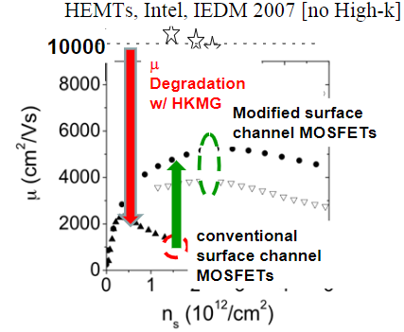
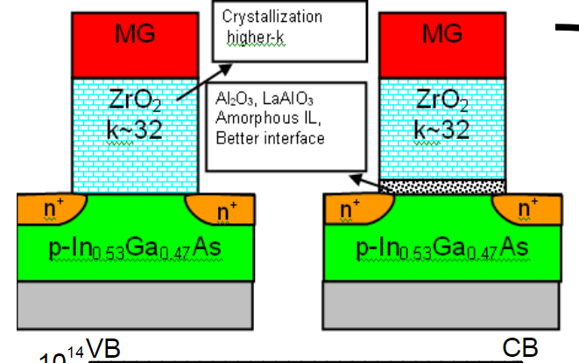
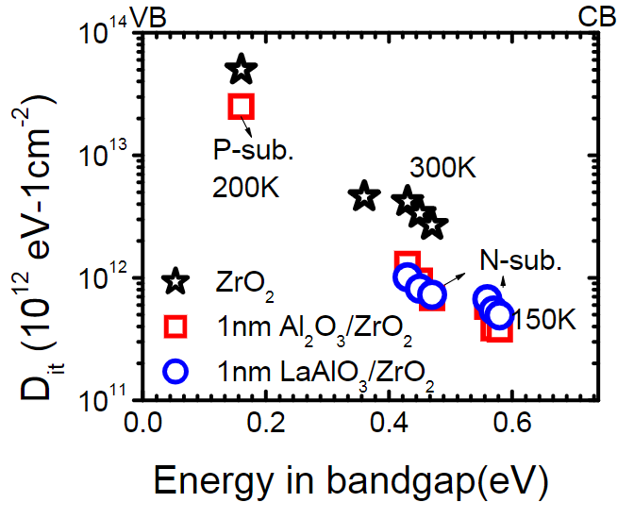
Ⅲ-Ⅴ MOSFET
Issues
・High density of interface states
→ gm degradation.
・Device fabrication on Si substrate.
https://studylib.net/doc/18330212/advanced-cmos-scaling

Slide 17
The era of Nano-Wire
・Nano-Wire=1-dimensional channel.
・Carrier can move toward 1-D direction.
→Less chance to meet phonon scattering.
→Potential for Ballistic-Transport（no Scattering）
Current
Nano-Wire
Source
Channel
Drain
Ballistic
Transport

Slide 18
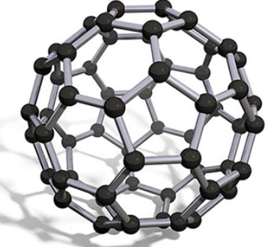
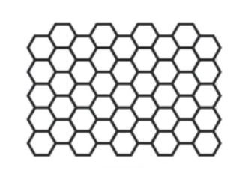
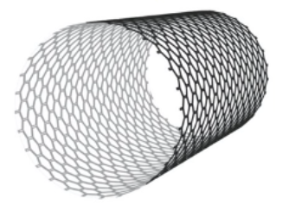
Carbon-Nano-Tube
Six-membered-Ring
CNT
Graphene
few nm
Roll
Diameter~1.2nm
Length~Several um
Pros
1 dimensional transport.
Mobility：36000cm²/Vs
Mechanically stable, high thermal conductivity.
Difficult to control Chirality.
Cons

Slide 19
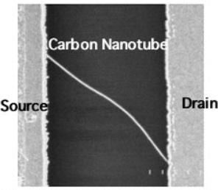
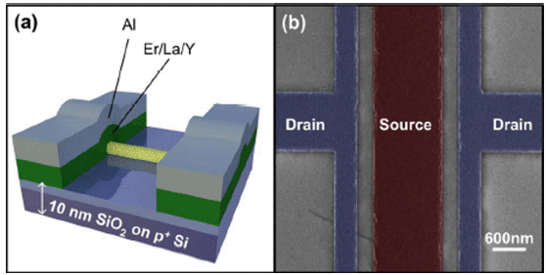
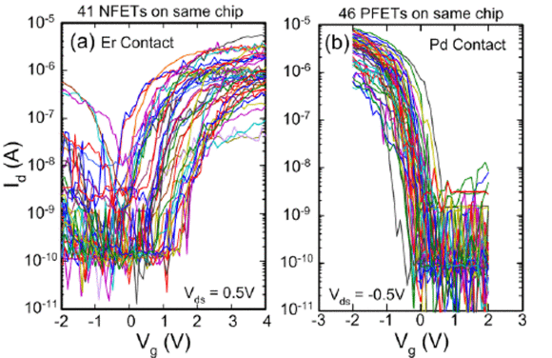
CNT MOSFET
Davood Shahrjerdi et. Al,”High device yield carbon nanotube NFETs for high-performance logic applications” IEDM 2011.
Solvent of CNT is spread on the film
of oxidized materials for device fabrication.

Slide 20
Chirality of CNT
Before
（Metallic Nature → Normally-On）
Conductivity
[Siemens]
After
（Semiconductor Nature → Normally Off）
0
Vg［Ｖ］
What happens when applying large bias.
Metallic part → Breakdown occur.
Semiconductor part→ Keep the same nature.
P.G Collins et.al.(IBM) Science 292, 706 (2001)

Slide 21
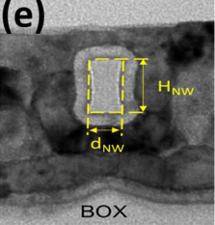
FinFET, Nano-Wire and Gate All Around
FinFET
Nanowire-Tr
Gate-All-Around Tr
Gate
Gate
Gate
SiO2
SiO2
SiO2
Fin-Channel
Fin-Channel
Fin-Channel
Si
Si
Si
Fin Width 10-20nm
Fin Height 25-50nm
Fin Width 10-15nm
Fin Height 10-15nm
Fin Width (dNW)
5,10,20,30,40 nm
Fin Height (HNW) 22 nm
Nanowire devices successfully take over More than Moore
era,
Anshul Gupta et.al,"Time Evolution of DIBL in
Gate-All-Around Nanowire MOSFETs During
Hot-Carrier Stress", IEEE Transactions on ED
(2021),Vo.68,Issue 6

Slide 22
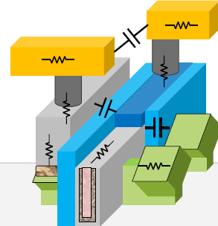
Fighting with Layout Parasitic Elements - To beat the era of “More than Moore” -

Slide 23
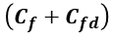
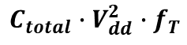
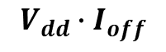
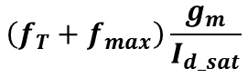
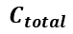

Figure Of Merit comparison toward 7nm
FinFET technology outperforms BULK-CMOS in all FoMs.
But The FOM tends to level off around 7nm node.
BULK-CMOS
Fin FET
$$\left(f_{T}+f_{max}\right)\frac{g_{m}}{I_{d_sat}}$$
$$C_{total}∙V_{dd}^{2}∙f_{T}$$
$$V_{dd}∙I_{off}$$
7nm
7nm
7nm
$$\left(C_{ovd}+C_{fd}\right)$$
FinFET
$$C_{total}$$
$$\left(C_{f}+C_{fd}\right)$$
BUK-CMOS
Reference
https://keep.lib.asu.edu/items/157985
Predictive Process Design Kits for the 7 nm and 5 nm Technology Nodes

Slide 24

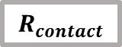
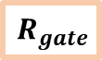
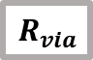

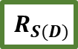
Price of Logic Density – Parasitic increase below 7nm -
Alvin Loke ,”ISSCC 2024 - Forum 3.1: Extending and Augmenting Analog with Digital to Overcome Technology Scaling Limitations”
$$R_{interconnect}$$
Mx.R
$$R_{via}$$
X3
$$R_{contact}$$
Mx Resistance (vs. 40nm)
Mx Capacitance (vs. 40nm)
$$R_{S(D)}$$
X3
Mx.C
$$R_{gate}$$
$$R_{well}$$
40nm
28nm
16nm
7nm
5nm
Resistance
□ Rinterconnects (mainly MEOL & lower BEOL)
□ Rcontact & Rvia ➜︎ severe IR droop
□ Rgate ➜︎ non-quasistatic effects
□ Rwell ➜︎ well-ties, latchup
Capacitance
□ Strong gate coupling to S/D contacts & overlying metal

Slide 25
Strategy of fighting Layout Parasitics (1/2)
SA
SB
Cgd
STI_W
STI_L
S
D
S
Cgs
Cgs
Cgd
+ Well Proximity Effects
SD
Cgd
Cgs
S
D
S

Slide 26
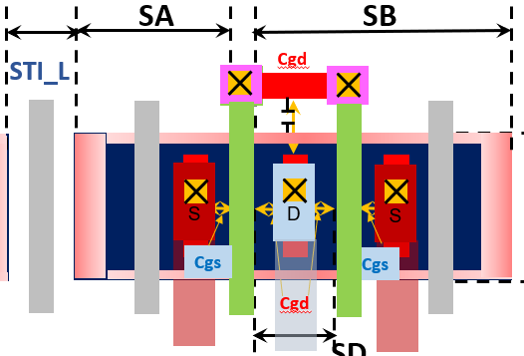
Compact Model Features
M1 1=D 2=G 3=S 4=B MOSMOD L=0.25u W=5u NF=1
AD=5p AS=5p PD=12u PS=12u NRD=0 NRS=0
SA=SA_val SB=SB_val SD=SD_val
SCA=SCA_val SCB= SCB_val SCC= SCC_val SCD= SCD_val
DELVTO=f(STI_L, STI_W,..) Mulu0= g(STI_L, STI_W,..)
.MODEL MOSMOD NMOS
LEVEL = 14
VERSION = 4.3.0
BINUNIT = 2
….
+MOBMOD = 1 RDSMOD = 0 IGCMOD = 0 IGBMOD = 0 CAPMOD = 2
+ RGATEMOD = 1 RBODYMOD = 1 TRNQSMOD = 1 ACNQSMOD = 1
+ TNOIMOD = 1 DIOMOD = 1 PERMOD = 1 GEOMOD = 0
…….
+SAREF = 5E-6 SBREF = 5E-6 KU0 = -4E-6
+KVSAT = 0.2 KVTH0 = -2E-8
….
- Available in the
Schematic symbols
- Synchronized with p-cell
Back annotated
after parasitic extraction
f() and g() are customized functions describing
VTH0 and U0 shift.

Slide 27
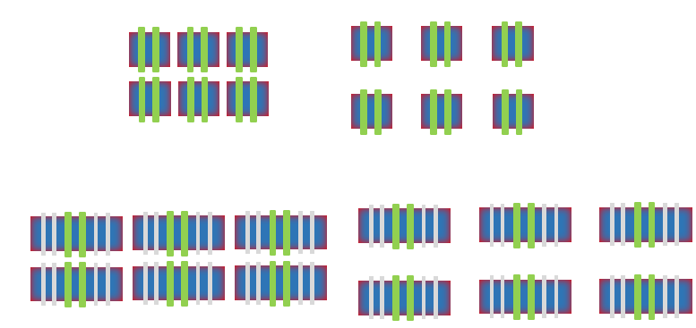


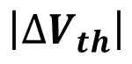
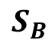
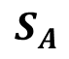
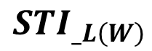
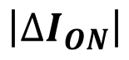
LDE Effect : How it shows up ?
$$\left|∆V_{th}\right|$$
$$\left|∆I_{ON}\right|$$
Stress effect
Fine Gate pitch
Small
$$S_{A}$$
$$S_{B}$$
Stress effect
Fine Gate pitch
$${STI}_{_L\left(W\right)}$$

Slide 28
Working with the reduction of R/C parasitic elements for higher cutoff frequency (fT and fMAX).
Distance
Long distance: CGD Rg
Negligible impact.
S
D
S
W
Narrow < 1um CGB , Rg
Sweet Spot ~1um
Wide > 1um Rg
Cgs
Cgs
NQS
Effect
Cgd
SD
SD
Long distance: CGD CJ
Cgd
Negligible impact.
Drain Routing Metal
Try to use as far routing layer as from the Gate electrode.
CGD
Cgs
S
D
S

Slide 29
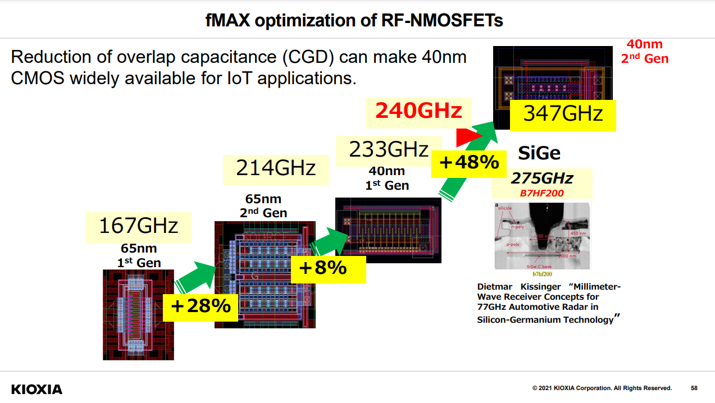
Layout optimization for the Tr speed faster than Moore’s prediction.
https://kobaweb.ei.st.gunma-u.ac.jp/lecture/20210729_analog_KIOXIA_Yoshitomi.pdf

Slide 30
Summary
More than Moore and Beyond CMOS toward 2030.
- New materials
- 1 dimensional carrier Transport may play a dominant
role. Linking to the GAA (Gate All Around) devices.
- Overcome the parasitic R/C influence owes designers’
technique.

